Slide 1


LIVING AND WORKING TOGETHER: INTEGRATING SYRIANS UNDER TEMPORARY PROTECTION (SuTPs) TO TURKISH ECONOMY
European Union Regional Trust Fund
(in Response to the Syrian Crisis The ‘Madad Fund’)

Slide 2

Overall Objective :
To strengthen the economic and social resilience of Syrians under Temporary Protection (SuTPs).
Notes:
At least 30.000 SuTPs/Turks will receive vocational guidance which enables them to be guided to (1) certification process within the project if they have existing vocational skills, or (2) vocational training programmes provided by other stakeholders if they do not have any vocational skills,
At least 15.000 SuTPs/Turks will be certified which enables them to validate their qualifications to enter in the labour market,

Slide 3
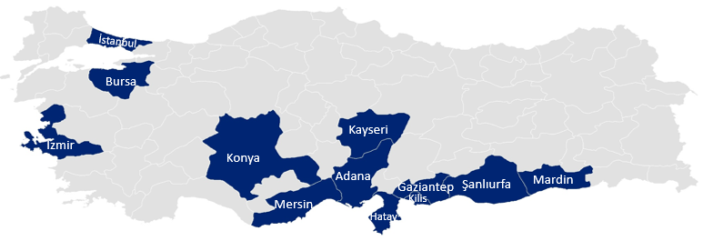
Location of the action:
12 provinces in Turkey with the highest Syrian population

Slide 4
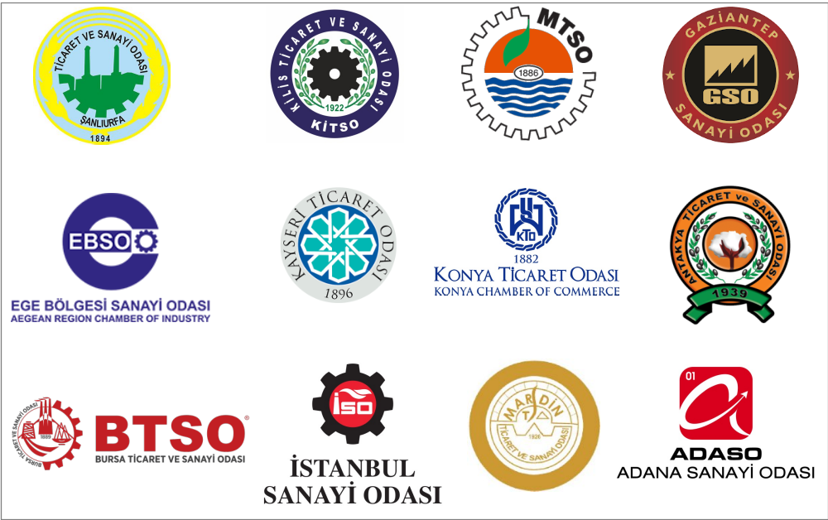
  Partner chambers:
Notes:
-For every regional chamber of commerce participating to the project, 3 dedicated new personal who are familiar with the Syrian culture will be hired to run the information desk full time. They will ensure outreach to the target communities, have language skills and cross cultural background to attract them to the chambers.

Slide 5
End beneficiaries:
Syrians under Temporary Protection (SuTPs) and host community members (%35)
Chambers and companies
Related public instutions and civil society organisations
Duration: 24 months
Budget: 15 million Euro
Notes:
At least 30.000 SuTPs/Turks will receive vocational guidance which enables them to be guided to (1) certification process within the project if they have existing vocational skills, or (2) vocational training programmes provided by other stakeholders if they do not have any vocational skills,
At least 15.000 SuTPs/Turks will be certified which enables them to validate their qualifications to enter in the labour market,

Slide 6
  ACTIVITY I: Network Setup and Project Coordination
Establish project team at TOBB
Establish project team at 12 partner chambers
Notes:
-For every regional chamber of commerce participating to the project, 3 dedicated new personal who are familiar with the Syrian culture will be hired to run the information desk full time. They will ensure outreach to the target communities, have language skills and cross cultural background to attract them to the chambers.
-Organize kick-off, coordination and closing events; create online Information centre to keep companies and Syrians updated about legal framework for employing Syrians, procedures of doing business, training opportunities, work permits, etc.

Slide 7
    ACTIVITY II: Labour Market Needs Analysis
Desk research
Field studies for demand side and supply side of the labour market
Training pool of vocational programmes

Slide 8
ACTIVITY III: Profile-Making
  Announce the project through Chambers and carry out public relations campaign to effectively disseminate the project activities;
  Select SuTPs (%65) and host community members (%35) to participate in project activities
Notes:
At least 30,000 SuTPs/Turks will receive skill mapping which enables them to receive vocational guidance in line with their existing skills and skills gaps.
Accession of SuTPs to vocational training programmes of public institutions and international NGOs will be facilitated
At least 30.000 SuTPs/Turks will receive vocational guidance which enables them to be guided to (1) certification process within the project if they have existing vocational skills, or (2) vocational training programmes provided by other stakeholders if they do not have any vocational skills,

Slide 9
ACTIVITY IV: Testing and Certification
  Prepare orientation programmes at voluntary companies
  Identify Authorised Certification Bodies
  Translate vocational standards and test material into Arabic;
  Test and certify SuTPs
Notes:
Employability of SuTPs will be increased.
At least 20.000 SuTPs/Turks will participate in preparation programmes (2 days) at voluntary companies which enables them to have prior understanding on the examination system using national qualifications, which are approved by the Vocational Qualifications Authority. At least 15.000 SuTPs/Turks will be certified which enables them to validate their qualifications to enter in the labour market,

Slide 10
  ACTIVITY V: Matchmaking
  Match companies and SuTPs at events called “speed dating days”
  Develop financial incentives for companies who employ certified SuTPs for approximately 6 months;
  Provide consultancy to companies who want to employ SuTPs.
  Turkish language training
Notes:
Matchmaking: Under this activity, companies and SuTPs and host community members will be matched at so called "Speed dating days". There will be approximately 150 speed dating dates. Companies operating in the sectors in line with the certified skills of SuTPs and host community members will be invited to these events.
Financial incentives for companies : Under this activity, companies that will employ 3000 certified SuTPs and host community members under the scope of the Project will be provided with financial incentives.
Turkish language courses: Approx. 2000 SuTPs will participate in Turkish language courses. These language trainings will be provided in local public training centers with free of charge based on cooperation agreement between MoNE and TOBB..

Slide 11
  ACTIVITY VI: Capacity Building for local chambers and companies
  Design and development of an online information centre
  In-house trainings for local project team experts
  Study visit to Germany: activity for learning from the experience of German Chambers in the context of integrating refugees into the economy.
Notes:
In-house trainings for local project team experts: This activity aims at building capacity in local project staff regarding as the work permissions procedures valid for SuTPs. Experts from MoLSS will be invited to inform the local staff in Ankara.
An online information centre will be developed to keep companies and SuTPs updated about legal framework for employing SuTPs, procedures of doing business, training opportunities, work permits, etc.
Study visit to Germany: This activity aims at learning from the experience of German Chambers in the context of integrating refugees into the economy.

Slide 12




LABOUR MARKET NEEDS ANALYSIS
Employment
APPLICATION
Application
+ Profile Making
Matchmaking+
consultancy
Speed dating days
Orientation programmes in the companies
(2 days)
Testing and certification
Turkish language courses

Slide 13










1) TARGET GROUP
1. skills mapping of SuTPs and host communities
+
2. needs analysis for companies
30.000
2) TEST & CERTIFICATION
15.000
3) PLACEMENT TO JOB/MATCHMAKING WITH COMPANIES
speed dating
3.000
Strategic partners:
Chambers
Companies
AUTHORISED IMPLEMENTING BODIES

Slide 14
Thank you for your kind interest..
Burcu ATILGAN
TOBB
EU DEPARTMENT
This publication was produced with the financial support of the European Union. Its contents are the sole responsibility of TOBB and do not necessarily reflect the views of the European Union.

